Slide 1
Lec 2: Fourier Series (SNS-Phase II)
Dr. Arsla Khan

Slide 2
Transformation Methods for CT signals
A real time naturally available signal is in the form of time domain
However, analysis of a signal is far more convenient in frequency domain.
A signal in its original form can not be defined in terms of frequency. Hence, by transformation methods, a time domain signal can be represented with respect to frequency components.
The three important transformation methods available in practice for a continuous time domain signals are as follows
Fourier Series
Fourier Transform
Laplace Transform

Slide 3
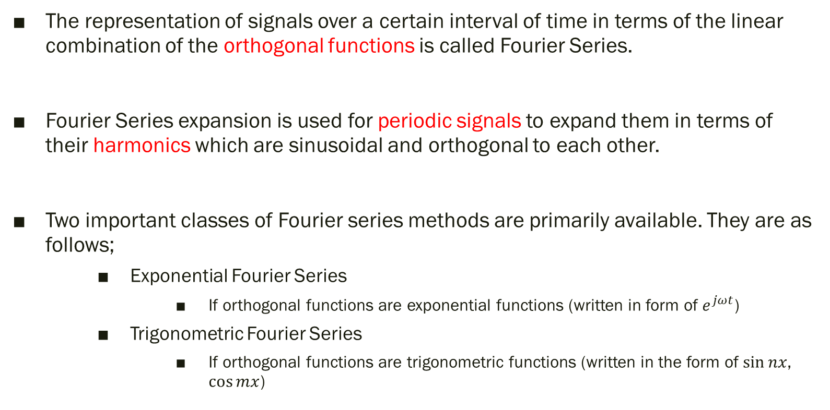
Fourier Series
The representation of signals over a certain interval of time in terms of the linear combination of the orthogonal functions is called Fourier Series.
Fourier Series expansion is used for periodic signals to expand them in terms of their harmonics which are sinusoidal and orthogonal to each other.
Two important classes of Fourier series methods are primarily available. They are as follows;
Exponential Fourier Series
If orthogonal functions are exponential functions (written in form of $e^{jωt}$)
Trigonometric Fourier Series
If orthogonal functions are trigonometric functions (written in the form of $\sin{nx}$, $\cos{mx}$)

Slide 4
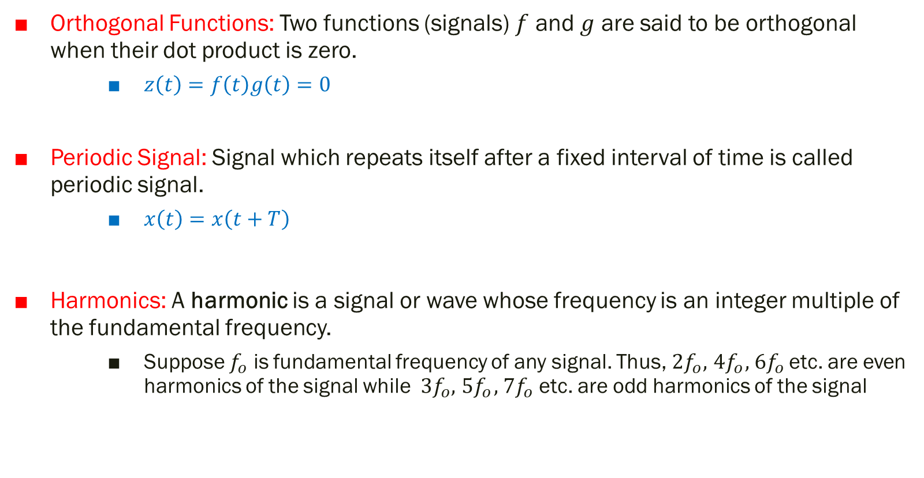
Orthogonal Functions: Two functions (signals) $f$ and $g$ are said to be orthogonal when their dot product is zero.
$z\left(t\right)=f\left(t\right)g\left(t\right)=0$
Periodic Signal: Signal which repeats itself after a fixed interval of time is called periodic signal.
$x\left(t\right)=x\left(t+T\right)$
Harmonics: A harmonic is a signal or wave whose frequency is an integer multiple of the fundamental frequency.
Suppose $f_{o}$ is fundamental frequency of any signal. Thus,${ 2f}_{o},{ 4f}_{o},{ 6f}_{o}$ etc. are even harmonics of the signal while ${ 3f}_{o},{ 5f}_{o},{ 7f}_{o}$ etc. are odd harmonics of the signal

Slide 5
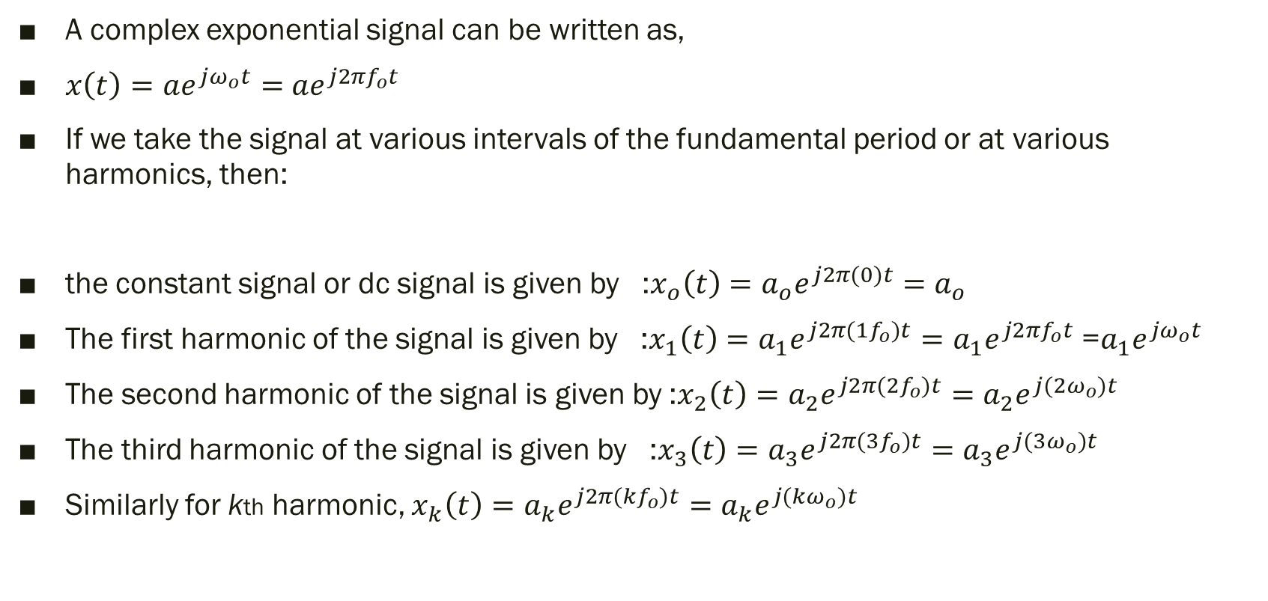
Derivative of Complex Exponential Fourier Series
A complex exponential signal can be written as,
$x\left(t\right)=ae^{jω_{o}t}=$ $ae^{j2πf_{o}t}$
If we take the signal at various intervals of the fundamental period or at various harmonics, then:
the constant signal or dc signal is given by :$x_{o}\left(t\right)=a_{o}e^{j2π(0)t}=$ $a_{o}$
The first harmonic of the signal is given by :$x_{1}\left(t\right)=a_{1}e^{j2π(1f_{o})t}=a_{1}e^{j2πf_{o}t}$ =$a_{1}e^{jω_{o}t}$
The second harmonic of the signal is given by :$x_{2}\left(t\right)=a_{2}e^{j2π(2f_{o})t}=a_{2}e^{j(2ω_{o})t}$
The third harmonic of the signal is given by :$x_{3}\left(t\right)=a_{3}e^{j2π(3f_{o})t}=a_{3}e^{j(3ω_{o})t}$
Similarly for kth harmonic, $x_{k}\left(t\right)=a_{k}e^{j2π(kf_{o})t}=a_{k}e^{j({kω}_{o})t}$

Slide 6
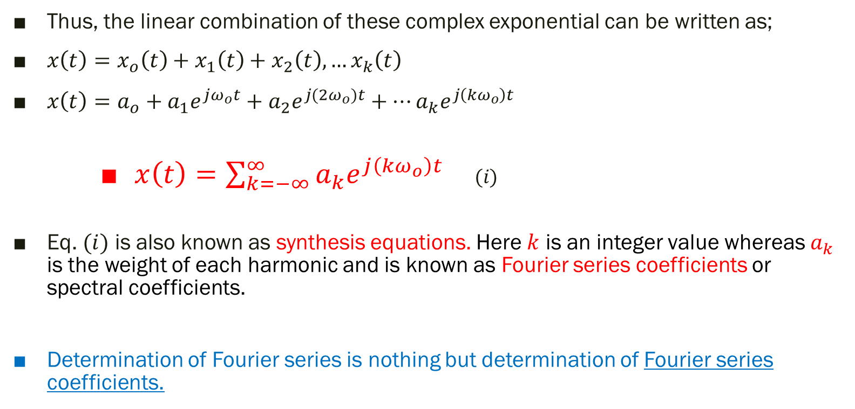
Thus, the linear combination of these complex exponential can be written as;
$x\left(t\right)=x_{o}\left(t\right)+x_{1}\left(t\right)+x_{2}\left(t\right), …x_{k}\left(t\right)$
$x\left(t\right)=a_{o}+a_{1}e^{jω_{o}t}+a_{2}e^{j(2ω_{o})t}+…a_{k}e^{j\left({kω}_{o}\right)t}$
$x\left(t\right)=\sum_{k=−∞}^{∞}{a_{k}e^{j\left({kω}_{o}\right)t}}$ $(i)$
Eq. $(i)$ is also known as synthesis equations. Here $k$ is an integer value whereas $a_{k}$ is the weight of each harmonic and is known as Fourier series coefficients or spectral coefficients.
Determination of Fourier series is nothing but determination of Fourier series coefficients.

Slide 7

How to find Fourier Series (FS) Coefficients
$a_{o}=\frac{1}{T_{o}}\int_{0}^{T_{o}}{x\left(t\right)dt}$ $(ii)$
$a_{k}=\frac{1}{T_{o}}\int_{0}^{T_{o}}{x\left(t\right)e^{−j\left({kω}_{o}\right)t}dt}$ $(iii)$
Eq. $(ii)$and $(iii)$ are known as Analysis Equation

Slide 8
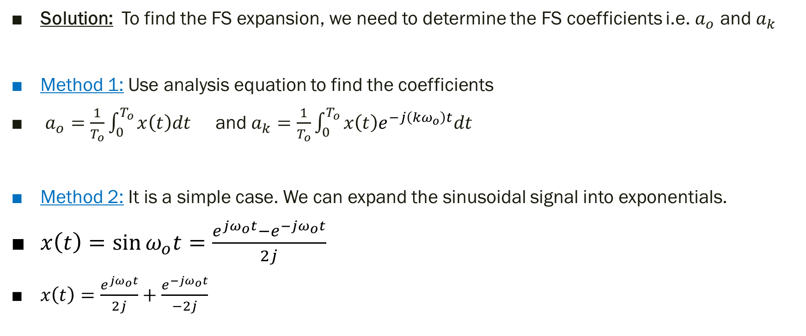
Exp 1: (Exp 3.3): Write FS expansion of the signal $x\left(t\right)=\sin{ω_{o}t}$
Solution: To find the FS expansion, we need to determine the FS coefficients i.e. $a_{o}$ and $a_{k}$
Method 1: Use analysis equation to find the coefficients
$a_{o}=\frac{1}{T_{o}}\int_{0}^{T_{o}}{x\left(t\right)dt}$ and $a_{k}=\frac{1}{T_{o}}\int_{0}^{T_{o}}{x\left(t\right)e^{−j\left({kω}_{o}\right)t}dt}$
Method 2: It is a simple case. We can expand the sinusoidal signal into exponentials.
$x\left(t\right)=\sin{ω_{o}t=\frac{e^{jω_{o}t}−e^{−jω_{o}t}}{2j} }$
$x\left(t\right)=\frac{e^{jω_{o}t}}{2j}+$ $\frac{e^{−jω_{o}t}}{−2j}$

Slide 9

$x\left(t\right)=\frac{1}{2j}e^{jω_{o}t}+$ $\frac{1}{−2j}e^{−jω_{o}t}$
By inspection, we can find that when
$k=1$,$e^{j{kω}_{o}t}$ → $e^{jω_{o}t}$
$k=−1$,$e^{j{kω}_{o}t}$ → $e^{−jω_{o}t}$
Therefore,
$a_{1}=\frac{1}{2j}$ and $a_{−1}=−\frac{1}{2j}$
$a_{k}=0 when k≠+1 and −1$

Slide 10
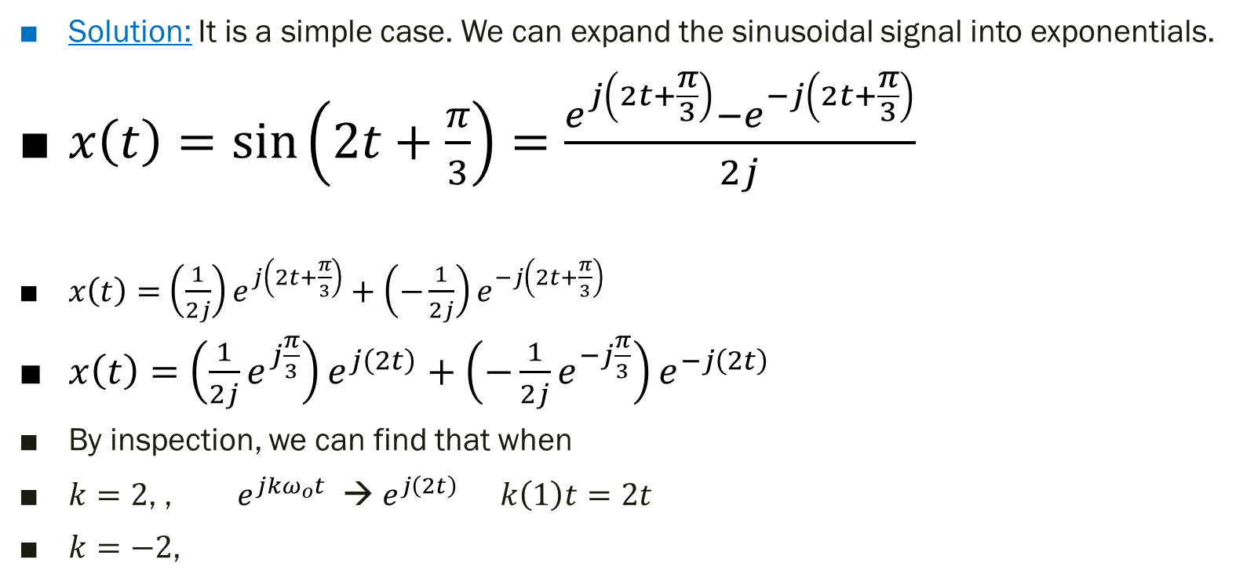
Exp 2: Write FS expansion of the signal $x\left(t\right)=\sin\left(2t+\frac{π}{3}\right)$
Solution: It is a simple case. We can expand the sinusoidal signal into exponentials.
$x\left(t\right)=\sin\left(2t+\frac{π}{3}\right)=\frac{e^{j\left(2t+\frac{π}{3}\right)}−e^{−j\left(2t+\frac{π}{3}\right)}}{2j}$
$x\left(t\right)=$ $\left(\frac{1}{2j}\right)e^{j\left(2t+\frac{π}{3}\right)}+\left(−\frac{1}{2j}\right)e^{−j\left(2t+\frac{π}{3}\right)}$
$x\left(t\right)=$ $\left(\frac{1}{2j}e^{j\frac{π}{3}}\right)e^{j\left(2t\right)}+\left(−\frac{1}{2j}e^{−j\frac{π}{3}}\right)e^{−j\left(2t\right)}$
By inspection, we can find that when
$k=2$, ,$e^{j{kω}_{o}t}$ → $e^{j\left(2t\right)}$ $k\left(1\right)t=2t$
$k=−2$,

Slide 11

Therefore,
$a_{2}=\left(\frac{1}{2j}e^{j\frac{π}{3}}\right)$ and $a_{−2}=\left(−\frac{1}{2j}e^{j\frac{π}{3}}\right)$
$a_{k}=0 when k≠+2 and −2$

Slide 12
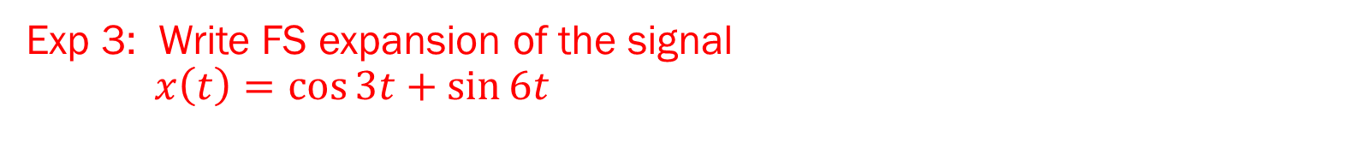
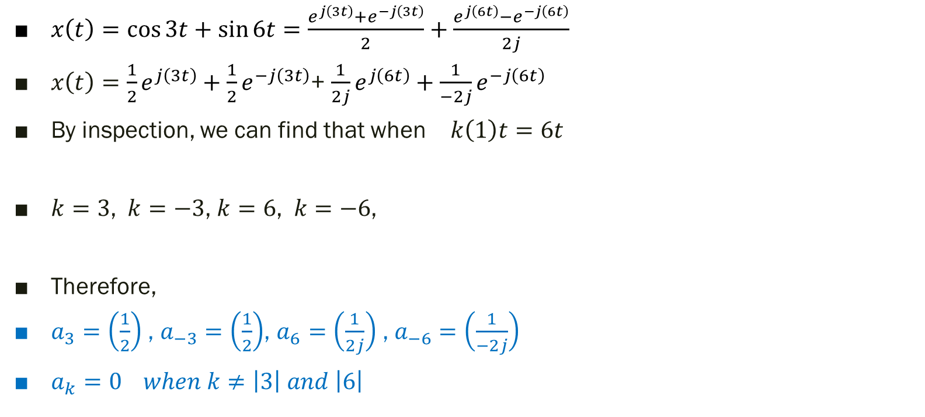
Exp 3: Write FS expansion of the signal $x\left(t\right)=\cos{3t}+\sin{6t}$
$x\left(t\right)=\cos{3t}+\sin{6t}=\frac{e^{j\left(3t\right)}+e^{−j\left(3t\right)}}{2}+\frac{e^{j\left(6t\right)}−e^{−j\left(6t\right)}}{2j}$
$x\left(t\right)=\frac{1}{2}e^{j\left(3t\right)}+\frac{1}{2}e^{−j\left(3t\right)}$+ $\frac{1}{2j}e^{j\left(6t\right)}+\frac{1}{−2j}e^{−j\left(6t\right)}$
By inspection, we can find that when $k\left(1\right)t=6t$
$k=3$,$k=−3$, $k=6$,$k=−6$,
Therefore,
$a_{3}=\left(\frac{1}{2}\right)$ , $a_{−3}=\left(\frac{1}{2}\right)$, $a_{6}=\left(\frac{1}{2j}\right)$ , $a_{−6}=\left(\frac{1}{−2j}\right)$
$a_{k}=0 when k≠\left|3\right| and \left|6\right|$

Slide 13
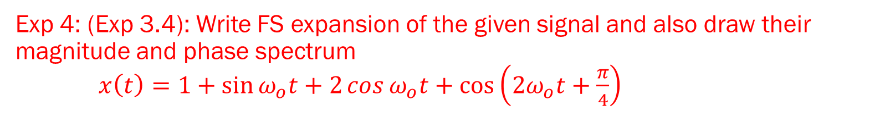
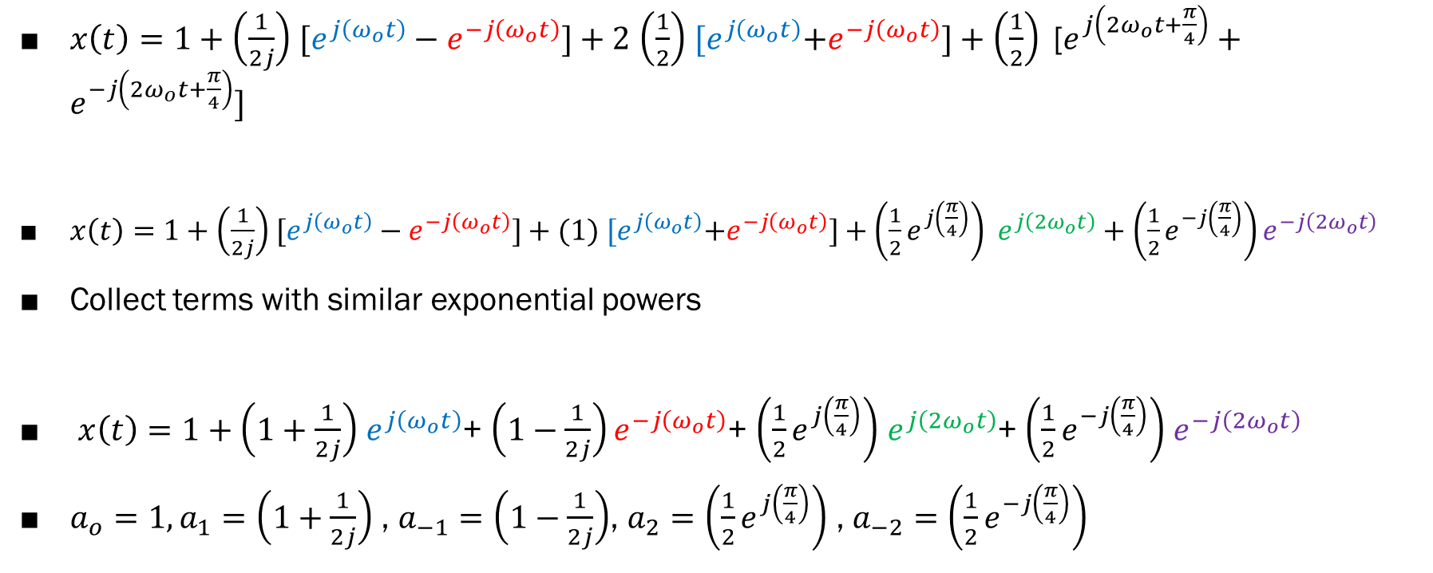
Exp 4: (Exp 3.4): Write FS expansion of the given signal and also draw their magnitude and phase spectrum $x\left(t\right)=1+\sin{ω_{o}t+2\cos{ω_{o}t}+\cos\left({2ω}_{o}t+\frac{π}{4}\right)}$
$x\left(t\right)=1+\left(\frac{1}{2j}\right)$ $[e^{j\left(ω_{o}t\right)}−e^{−j\left(ω_{o}t\right)}]+2$ $\left(\frac{1}{2}\right)$ ${[e}^{j\left(ω_{o}t\right)}+e^{−j\left(ω_{o}t\right)}]+\left(\frac{1}{2}\right) \text{[}e^{j\left({2ω}_{o}t+\frac{π}{4}\right)}+e^{−j\left({2ω}_{o}t+\frac{π}{4}\right)}]$
$x\left(t\right)=1+\left(\frac{1}{2j}\right)$ $[e^{j\left(ω_{o}t\right)}−e^{−j\left(ω_{o}t\right)}]+(1)$ ${[e}^{j\left(ω_{o}t\right)}+e^{−j\left(ω_{o}t\right)}]+\left(\frac{1}{2}e^{j\left(\frac{π}{4}\right)}\right) e^{j\left({2ω}_{o}t\right)}+\left(\frac{1}{2}e^{−j\left(\frac{π}{4}\right)}\right)e^{−j\left({2ω}_{o}t\right)}$
Collect terms with similar exponential powers
$x\left(t\right)=1+\left(1+\frac{1}{2j}\right)$ $e^{j\left(ω_{o}t\right)}$+ $\left(1−\frac{1}{2j}\right)e^{−j\left(ω_{o}t\right)}$+ $\left(\frac{1}{2}e^{j\left(\frac{π}{4}\right)}\right)$ $e^{j\left({2ω}_{o}t\right)}$+ $\left(\frac{1}{2}e^{−j\left(\frac{π}{4}\right)}\right)$ $e^{−j\left({2ω}_{o}t\right)}$
${a_{o}=1, a}_{1}=\left(1+\frac{1}{2j}\right)$ , $a_{−1}=\left(1−\frac{1}{2j}\right)$, $a_{2}=\left(\frac{1}{2}e^{j\left(\frac{π}{4}\right)}\right)$ , $a_{−2}=\left(\frac{1}{2}e^{−j\left(\frac{π}{4}\right)}\right)$

Slide 14

$a_{o}=1$
$a_{+1}=\left(1+\frac{1}{2j}\right)=$ $1−\frac{1}{2}j$
$a_{−1}=\left(1−\frac{1}{2j}\right)=1+\frac{1}{2}j$
$a_{2}=\left(\frac{1}{2}e^{j\left(\frac{π}{4}\right)}\right)= \frac{1}{2}(cos{\frac{π}{4}+jsin\frac{π}{4})}=\frac{1}{2}(cos{{45}^{o}+jsin{45}^{o})=}$ $\frac{1}{2}\left(\frac{\sqrt{2}}{2}+j\frac{\sqrt{2}}{2}\right)=\frac{\sqrt{2}}{4}(1+j)$
$a_{2}=\frac{\sqrt{2}}{4}(1+j)$
$a_{−2}=\left(\frac{1}{2}e^{−j\left(\frac{π}{4}\right)}\right)= \frac{1}{2}(cos{\frac{π}{4}−jsin\frac{π}{4})}=\frac{1}{2}(cos{{45}^{o}−jsin{45}^{o})=} \frac{1}{2}\left(\frac{\sqrt{2}}{2}−j\frac{\sqrt{2}}{2}\right)=\frac{\sqrt{2}}{4}(1−j)$
$a_{−2}=$ $\frac{\sqrt{2}}{4}(1−j)$
$a_{k}=0 for \left|k\right|>2$

Slide 15
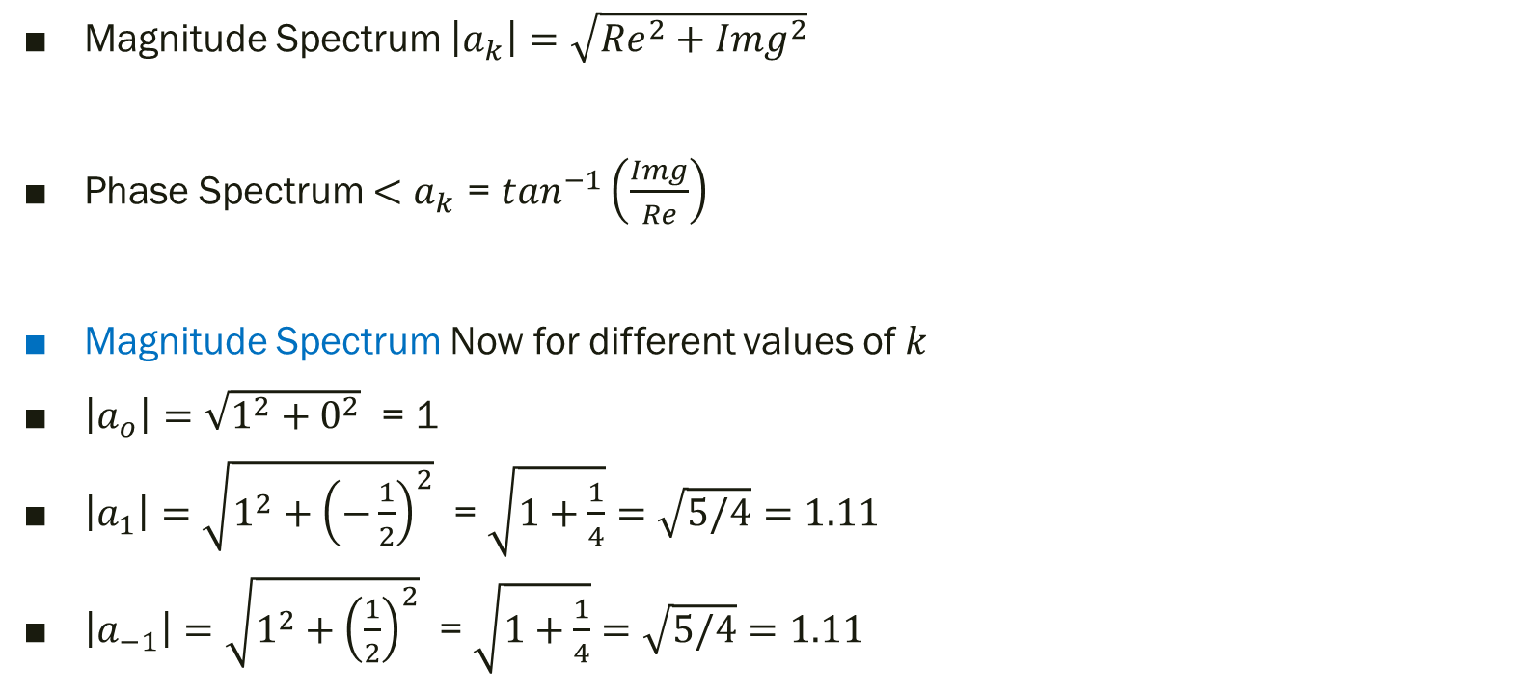
Magnitude and Phase Spectrum
Magnitude Spectrum $\left|a_{k}\right|=\sqrt{{Re}^{2}+{Img}^{2}}$
Phase Spectrum $<a_{k}$ = $\tan^{−1}\left(\frac{Img}{Re}\right)$
Magnitude Spectrum Now for different values of $k$
$\left|a_{o}\right|=\sqrt{1^{2}+0^{2}}$ = 1
$\left|a_{1}\right|=\sqrt{1^{2}+{\left(−\frac{1}{2}\right)}^{2}}$ = $\sqrt{1+\frac{1}{4}}=\sqrt{5/4}=1.11$
$\left|a_{−1}\right|=\sqrt{1^{2}+{\left(\frac{1}{2}\right)}^{2}}$ = $\sqrt{1+\frac{1}{4}}=\sqrt{5/4}=1.11$

Slide 16


$\left|a_{2}\right|=\sqrt{{\left(\frac{\sqrt{2}}{4}\right)}^{2}+{\left(\frac{\sqrt{2}}{4}\right)}^{2}}$ = $\sqrt{\frac{2}{16}+\frac{2}{16}}=\sqrt{4/16}=\frac{2}{4}=0.5$
$\left|a_{−2}\right|=\sqrt{{\left(\frac{\sqrt{2}}{4}\right)}^{2}+{\left(−\frac{\sqrt{2}}{4}\right)}^{2}}$ = $\sqrt{\frac{2}{16}+\frac{2}{16}}=\sqrt{4/16}=\frac{2}{4}=0.5$

Slide 17
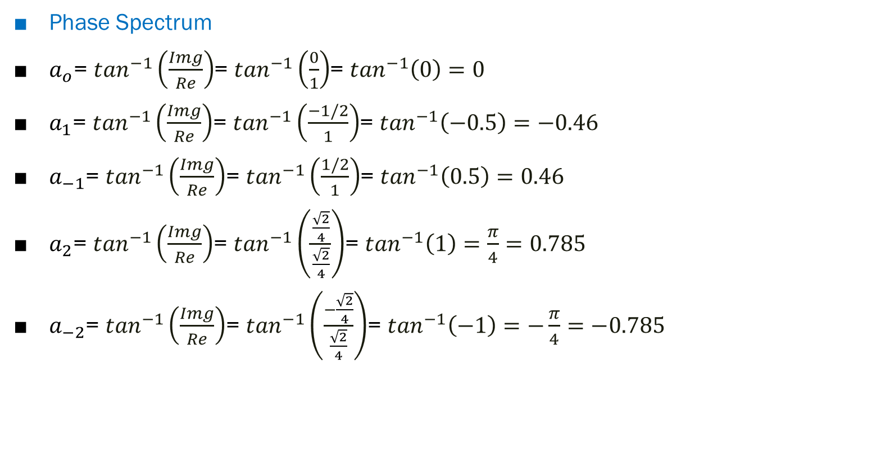
Phase Spectrum
$a_{o}$= $\tan^{−1}\left(\frac{Img}{Re}\right)$= $\tan^{−1}\left(\frac{0}{1}\right)$= $\tan^{−1}\left(0\right)=0$
$a_{1}$= $\tan^{−1}\left(\frac{Img}{Re}\right)$= $\tan^{−1}\left(\frac{−1/2}{1}\right)$= $\tan^{−1}\left(−0.5\right)=−0.46$
$a_{−1}$= $\tan^{−1}\left(\frac{Img}{Re}\right)$= $\tan^{−1}\left(\frac{1/2}{1}\right)$= $\tan^{−1}\left(0.5\right)=0.46$
$a_{2}$= $\tan^{−1}\left(\frac{Img}{Re}\right)$= $\tan^{−1}\left(\frac{\frac{\sqrt{2}}{4}}{\frac{\sqrt{2}}{4}}\right)$= $\tan^{−1}\left(1\right)=\frac{π}{4}=0.785$
$a_{−2}$= $\tan^{−1}\left(\frac{Img}{Re}\right)$= $\tan^{−1}\left(\frac{−\frac{\sqrt{2}}{4}}{\frac{\sqrt{2}}{4}}\right)$= $\tan^{−1}\left(−1\right)=$ $−\frac{π}{4}=−0.785$

Slide 18

Magnitude Spectrum follows even symmetry
Phase Spectrum follows odd symmetry

Slide 19
Thank You !!!

